Slide 1
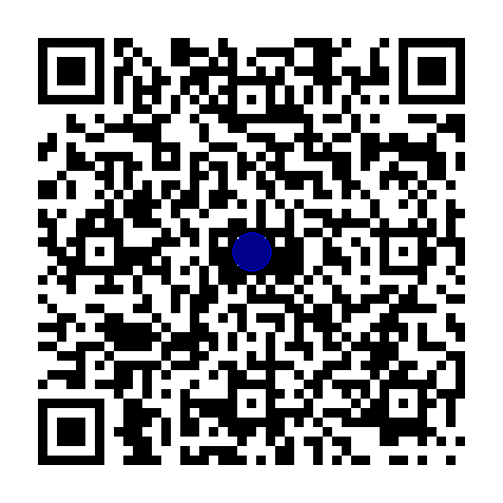
DSPy:
A prograMmatic paradigm for LLM application optimization
Or: How I Learned to Stop Prompting and Love AI!
Lars Bell • larsbell@gmail.com

Slide 2

Prompting is Weird…
Strategies that “work”
Threatening
Emotional Blackmail
Bribe
Grovel
Do you version control your Prompts?
Prompting Can Be Fragile
Results change by Check Point or Model
Prompting can be non predictive

Slide 3
Screw all that.
We live in world where LLMs are good at writing words.
Let’s make AI write many possible prompts.
Make your computer test every prompt combination.
Then prove, with math, which is the optimal combination of prompts for your workflow
Welcome to DSPy!

Slide 4
Ok, the AI is writing the Prompts. What is left for me to do?
Data. You still need high quality input data. The more the better.
You still need to design and improve the program. The architecture of the logic.
Metrics. You define the quality of the output.

Slide 5
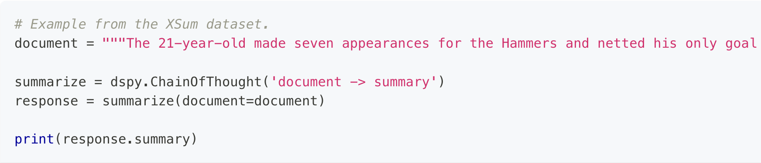
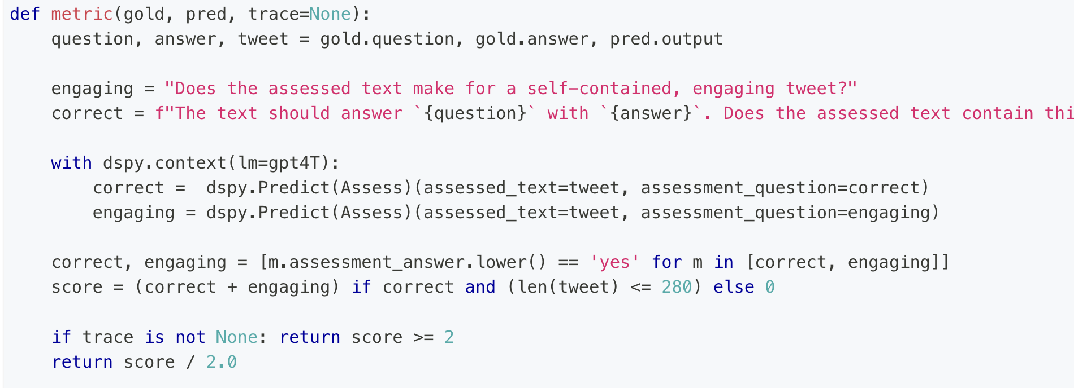




What does the code look like?

Slide 6
We now have:
Systematic Optimization
Modular Approach
Cross-LM Compatibility
Confidence we have the optimal prompts for our system.

Slide 7
“There is no difference between Prompting and Fine Tuning when you are doing neither.”
-- Omar Khattab, Head Creator of DSPy
Bonus: you can graduate to fine tuning with the same system.

Slide 8
Lars Bell • larsbell@gmail.com

